Slide 1
Collaborative Platform Version 5.0
Team Members
Product Owner
Adrian Alfonso
Juan Caraballo
Jorge Travieso

Slide 2
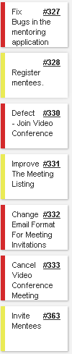
Sprint 5 Stories
Total 64 pts

Slide 3



My Sprint 5 Stories (Total 40 pts)
Week 1 Stories completed
Week 2 Stories completed

Slide 4
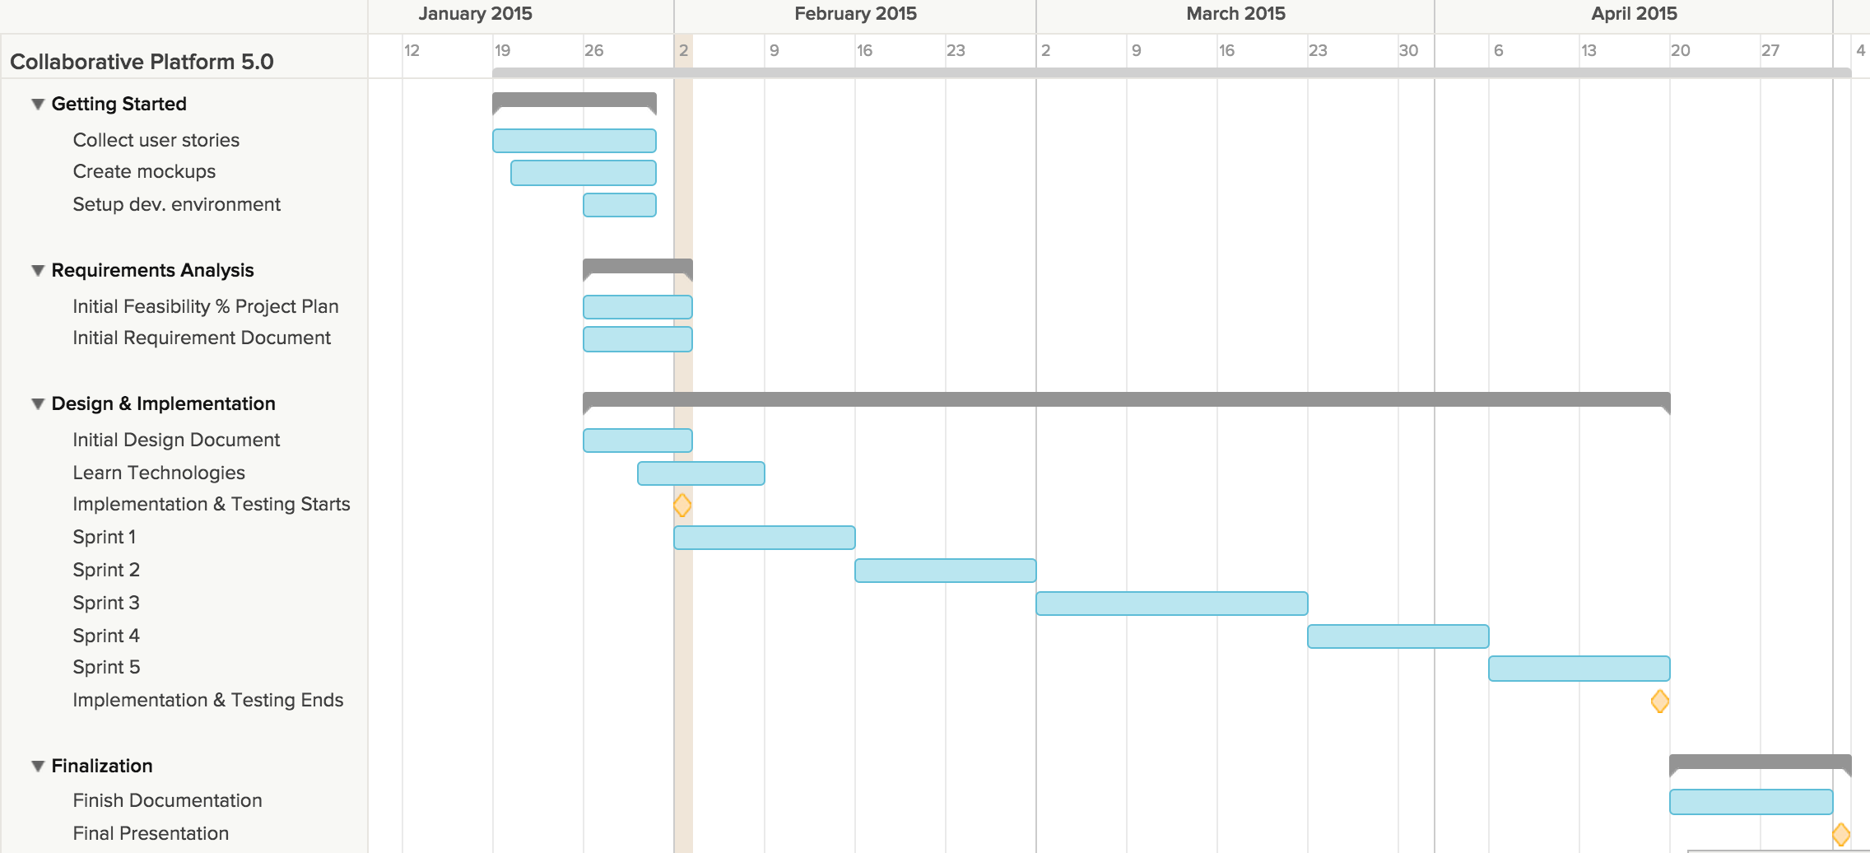
Project plan

Slide 5
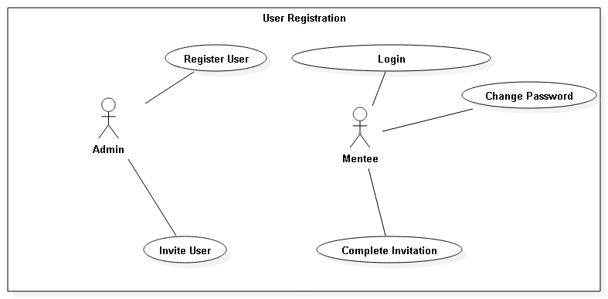
Use Cases

Slide 6
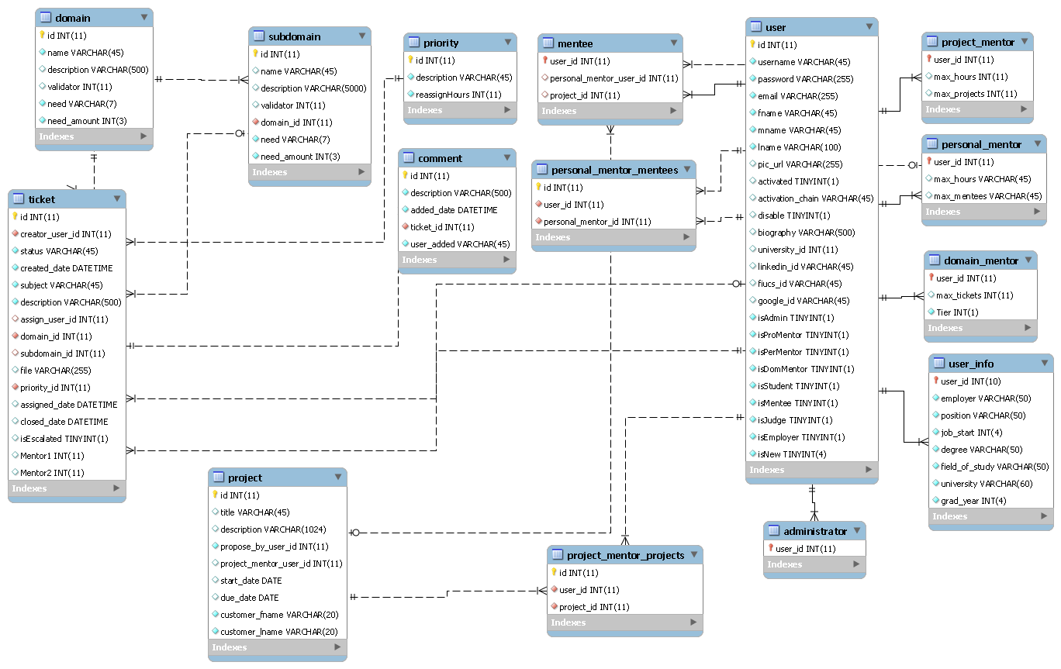
ER Diagram

Slide 7
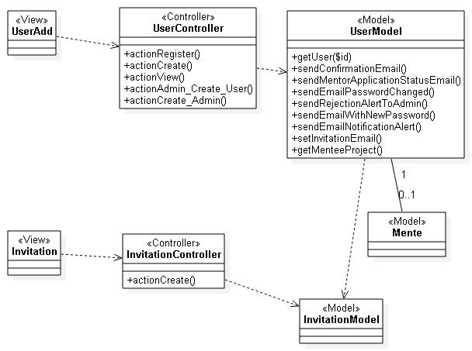
Class Diagram

Slide 8
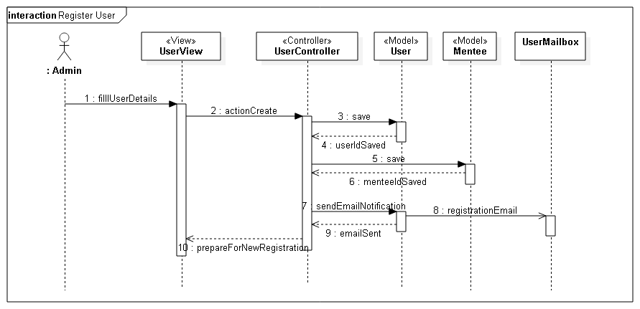
Sequence Diagram (Register Mentee)

Slide 9
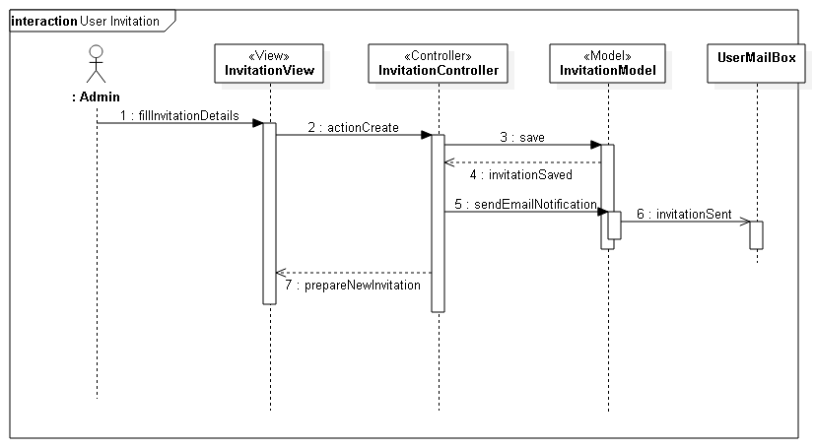
Sequence Diagram (Register Mentee)

Slide 10
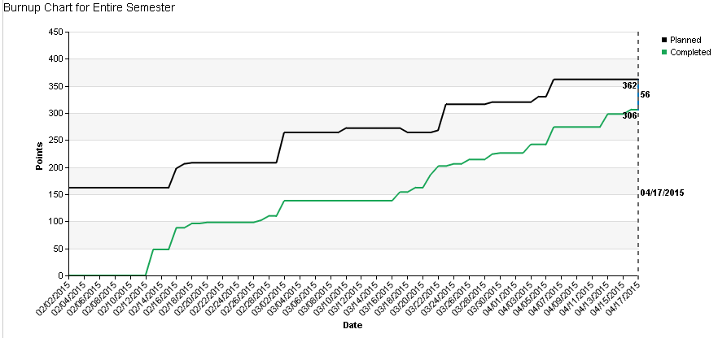
Burnup chart

Slide 11
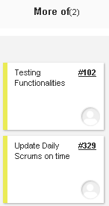
Retrospective

